Slide 1

Comprehensive Analysis of the Amazon Mobile Phone Market
Data Analytics Project
Presented by Group 10

Slide 2
Introduction
Brief overview of the Project:
This project involves the analysis of a dataset containing information on cell phones sold on Amazon.
The primary objective was to uncover trends in pricing, specifications, discounts, and customer satisfaction, helping us better understand the market dynamics.

Slide 3
Understanding the problem
Smartphone prices are shaped by features like storage, brand, and display size, but their impact on price varies across models.
This analysis explores how these factors influence pricing to help consumers find better deals and guide manufacturers in setting fair prices.
This analysis aims to explore and answer the following questions:
Which brand has the most ratings?
What is the relationship between price and ratings.
Does screen size, RAM, Storage affects product prize? etc
By identifying patterns in the pricing of smartphones based on this analysis can provide valuable insights for:
Consumers
Retailers
Ecom seller
Manufactures

Slide 4
Project objective:
Analyze Pricing trends across different brands.
Study the impact of specifications (storage, RAM) on price.
Examine discount patterns and their impact on price.
Identify the most common operating systems.
Investigate consumer ratings and their relationship with price.
Analyze popularity based on the number of reviews.

Slide 5
Dataset Overview
Number of Records: The dataset contains 3,351 products.
Key Attributes:
Product Name
Brand
Price (Dollar)
Discount Percentage
Price Before Discount
Rating (Out of 5)
Number of Ratings
Operating System
RAM (GB)
Storage (GB)

Slide 6
Statistical Methods Used:
Descriptive statistics: Mean, median, standard deviation to summarize the data.
Correlation analysis: Pearson correlation to study the relationship between price and ratings.
ANOVA test: To check if the mean price significantly differs across storage capacities and brands.
Chi-square test: To determine the independence between categorical variables (e.g., brand and operating system).
Box Plots & Scatter plots: To visualize price variations and detect outliers.
Bar Graphs & Hexbin plots: To explore relationships between continuous variables.

Slide 7
Tools & Technologies
Tools:
Python, Pandas, Matplotlib, Seaborn and Google Colab.
Technologies
Data cleaning, Data Visualization, Statistical Analysis, Correlation Analysis, Exploratory Data Analysis(EDA).

Slide 8
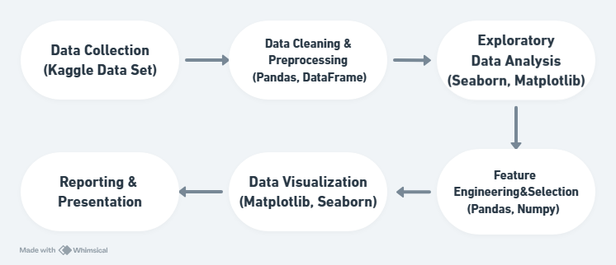
Workflow

Slide 9
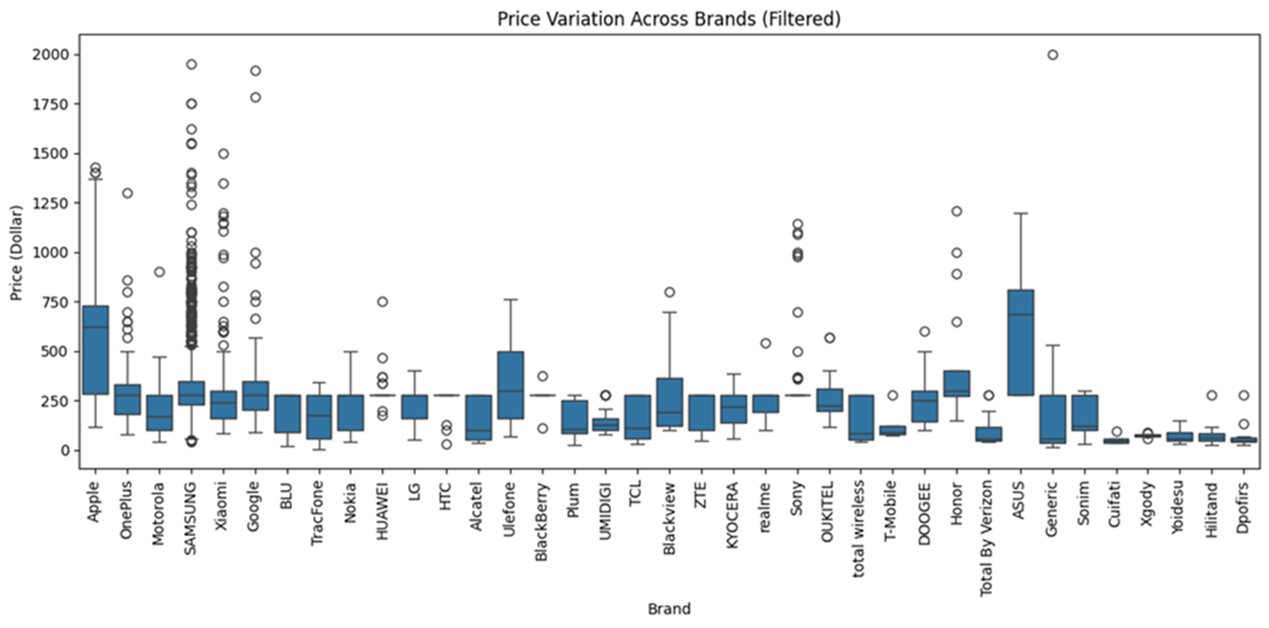
Pricing Trend analysis
Observations:
Premium brands like Apple and Samsung have higher price ranges.
Budget brands, like Xiaomi, dominate lower price ranges.
Some brands, like OnePlus, offer products in both mid and high price segments.

Slide 10
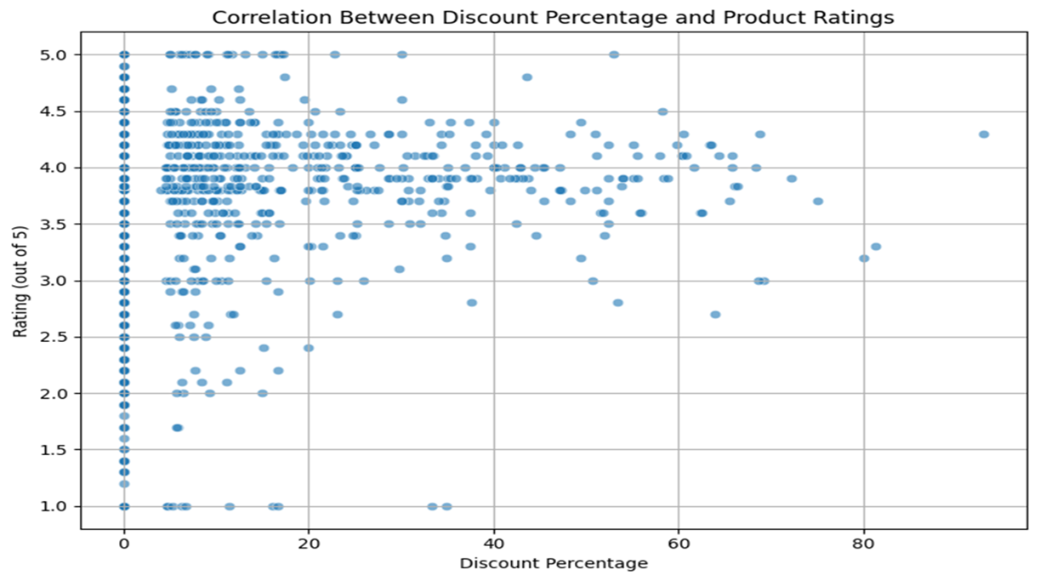
Correlation Between Discount Percentage and Product Ratings
Observations:
Most highly rated products (4–5 stars) are at lower discounts (0–20%).
Some products with high discounts (40–80%) have decent ratings, but they’re less common.
Products with ratings below 3 are distributed across all discount ranges.

Slide 11
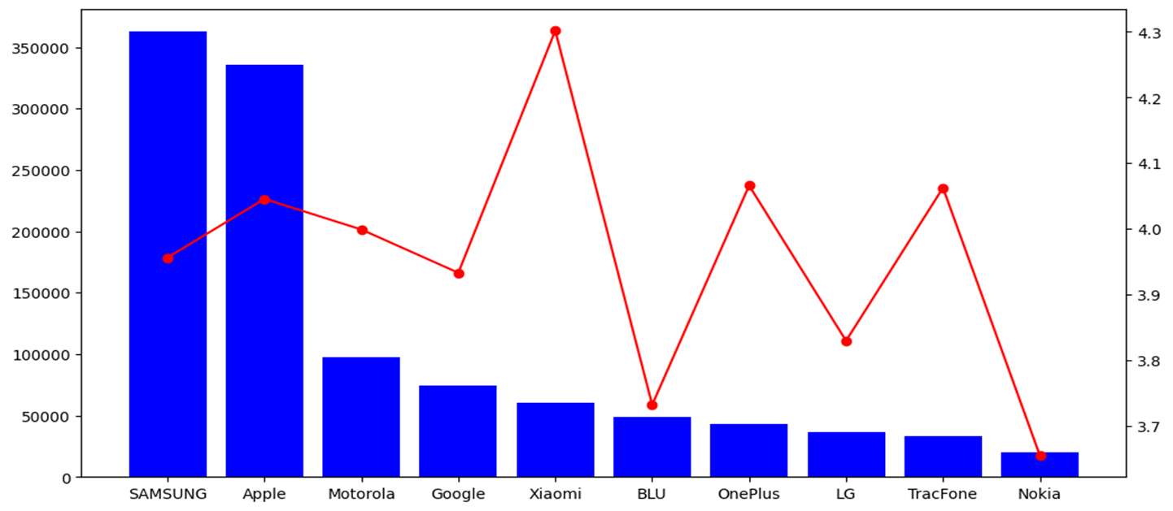
Top brands based on Average Ratings and Number of Ratings
Observation:
Popular brands attract more reviews, which builds customer trust
Niche brands may have fewer users but can maintain high satisfaction.

Slide 12
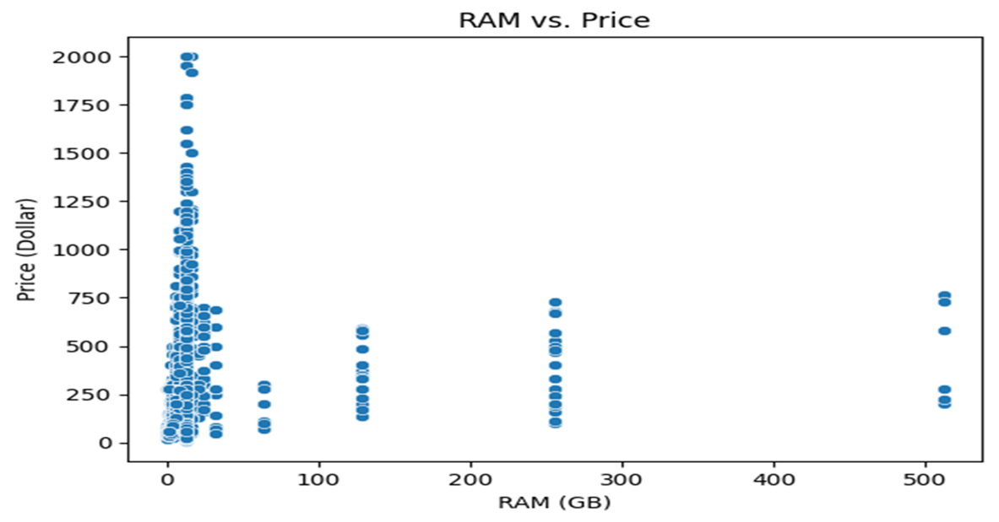
Specification Analysis:
Analyse Whether Phones With Higher RAM are Priced Significantly Higher
Observations:
More RAM usually means higher prices, but budget-friendly options exist.
This trend helps customers balance performance and cost.

Slide 13
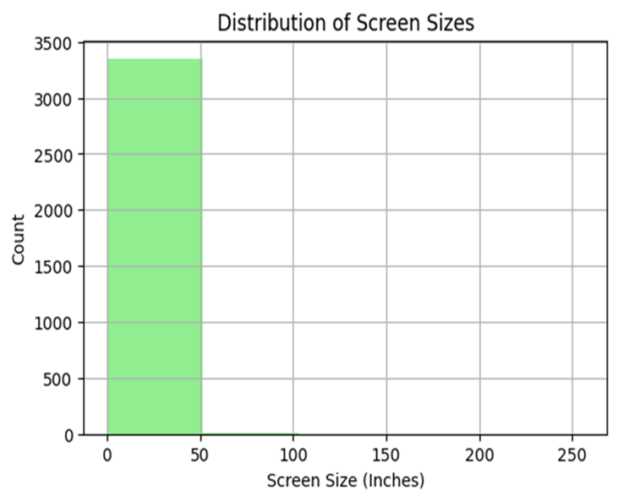
Screen Size Distribution
Identifying The Most Common Screen Sizes
Observations:
Customers prefer larger screens for multimedia use.
Smaller screens cater to niche markets focused on portability.

Slide 14
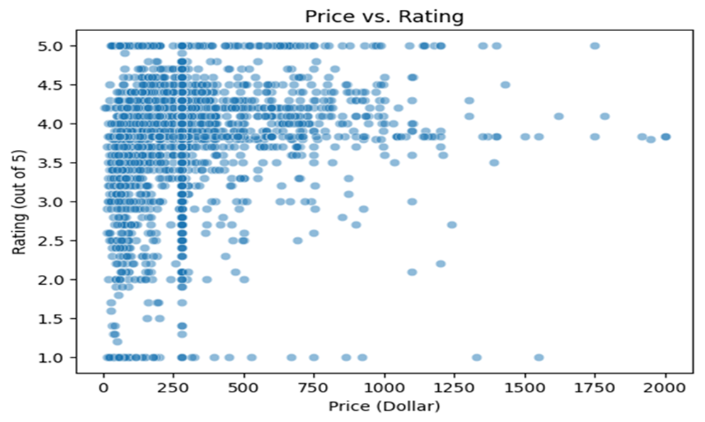
Rating Analysis
Examine Factors Affecting Product Ratings
Observations:
Overpriced products but poorly rated.
Mid-range phones often balance price and features, leading to better ratings.

Slide 15
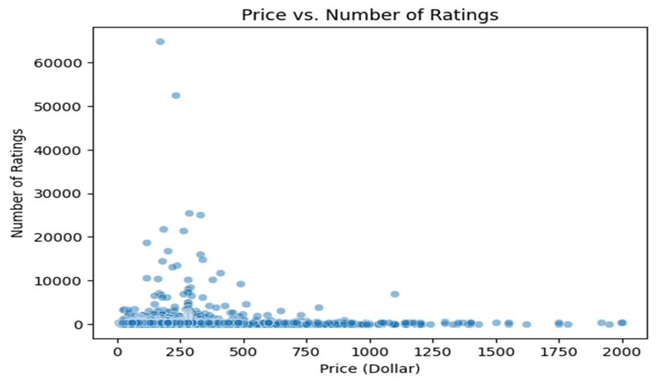
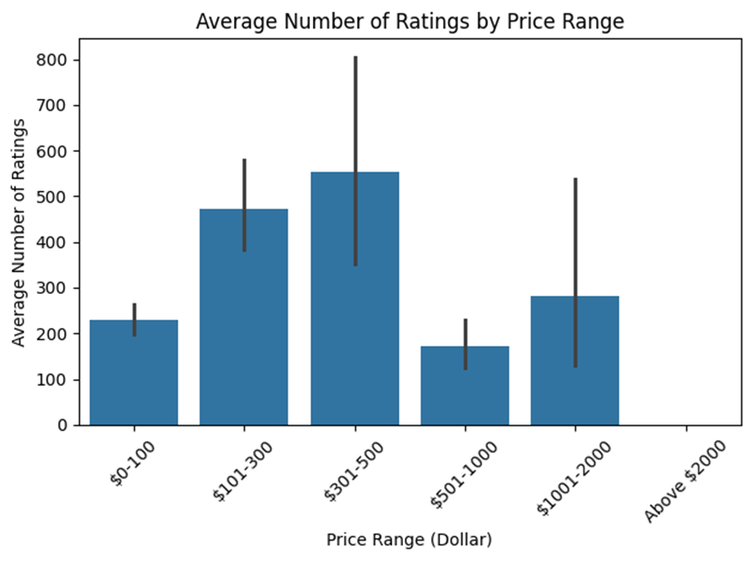
Price vs Number of Ratings

Slide 16
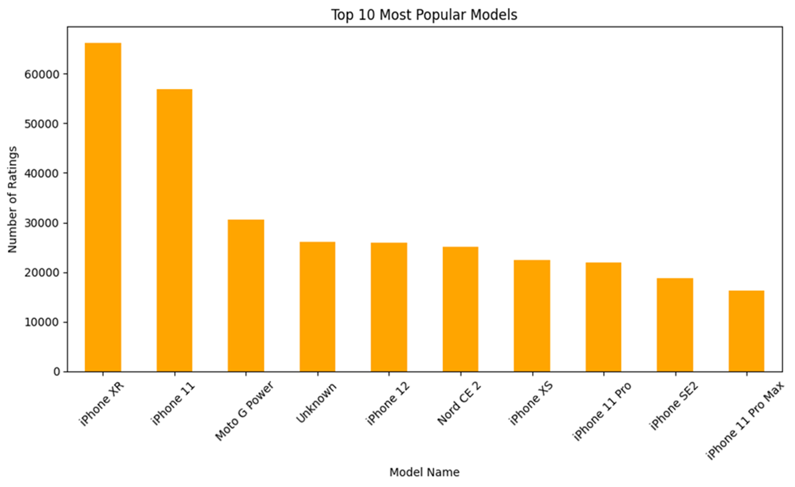
Popularity Analysis
Determine Which Brand and Models are Most Popular
Observations:
Popular models often belong to well-known brands.
Features, price, and marketing contribute to their success.

Slide 17
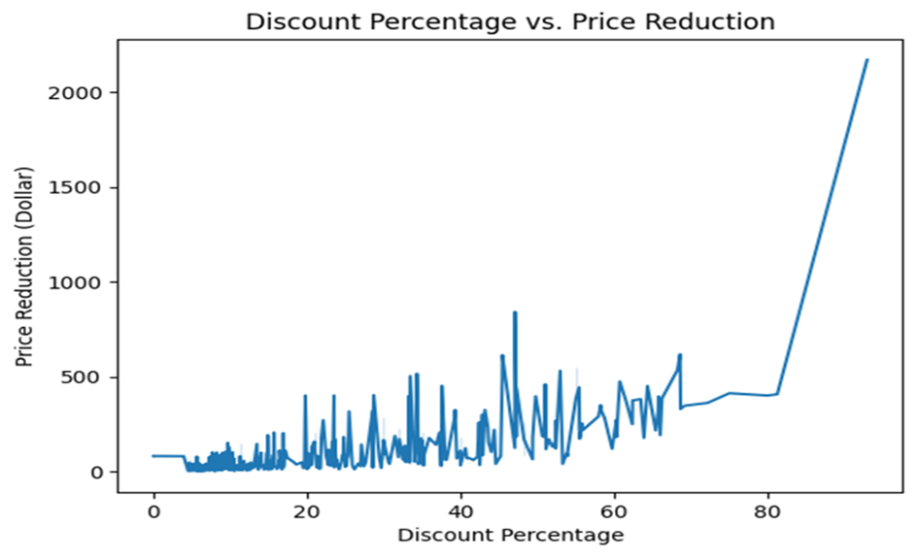
Discount Analysis
Discount VS Price Reduction
Observations:
Higher discounts don’t always mean big price drops.
Some products offer small price reductions even with high discounts.

Slide 18
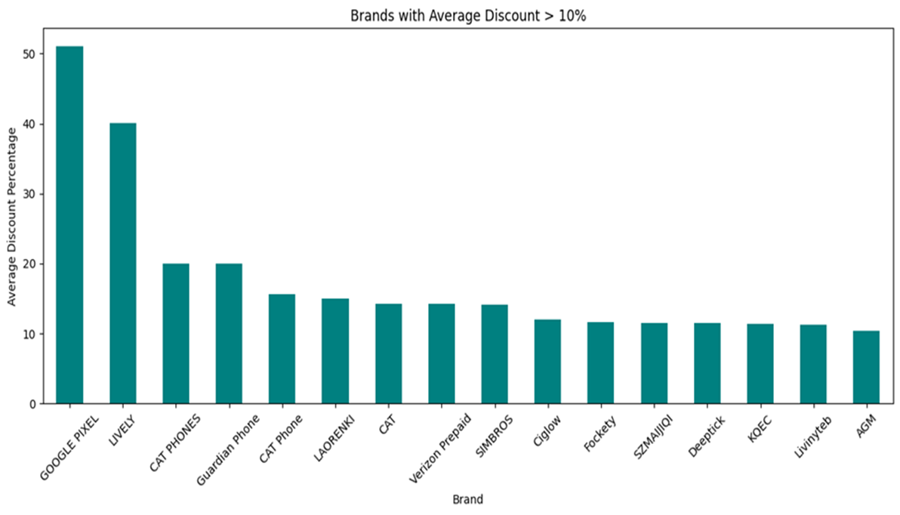
Discount by Brands
Observations:
Some brands rely heavily on discounts to attract buyers.
Others focus on maintaining consistent pricing.

Slide 19
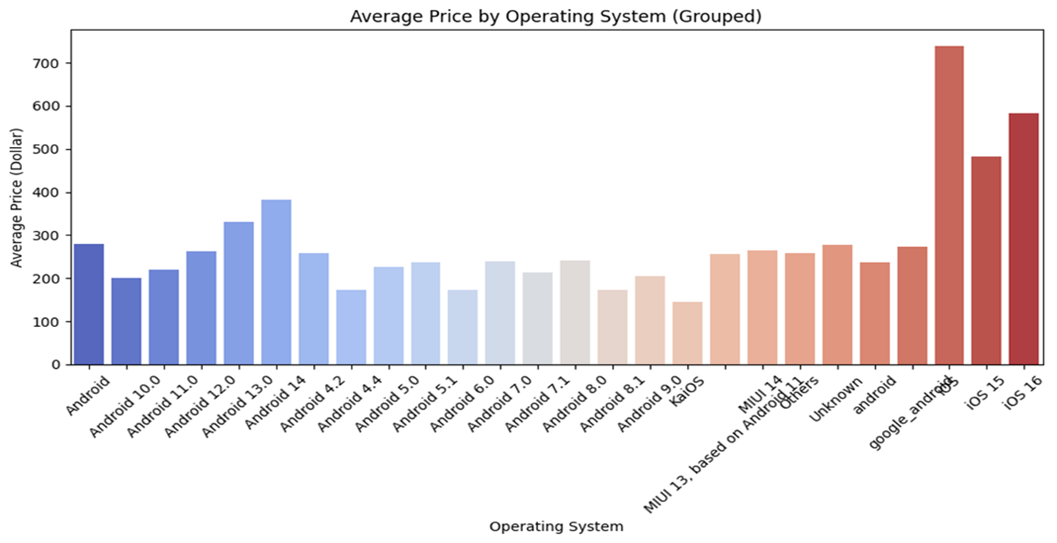
Operating System Trends
Examine The Popularity and Price Of Different Operating Systems
Observations:
Android dominates the budget and mid-range segments.
iOS is mostly found in premium price ranges.

Slide 20
Future Development
Customer reviews will be incorporated, whether good or harsh reviews working in well-structured phrases rather than ratings, sentiment analysis, and understanding consumer preferences insightfully.
Also, there are additional qualities to be added to the technical specifications, including the quality of the camera, the capacity of the battery, and the details of the processor, which provide more excellent product comparisons.
Time-Oriented Analysis: Time stamps with ratings and price fluctuations are implemented, following the trends to see how discounts affect sales in specific seasons or events.
Expansion of Market Segments: Having all the information present will allow these regions to compare regional prices and availability with other areas of the world.

Slide 21
Conclusion
Pricing varies significantly by brand and product specifications.
Both budget and premium phones can achieve high ratings, highlighting the importance of value for money.
Discounts are more prevalent in the mid-range and budget segments.
Android is the dominant operating system, followed by iOS.
Popularity is driven by factors such as ratings, reviews, and time on the market.

Slide 22
The Team
Vighnesh Gajula
Lavan Kumar Gaddam
Killari Vyshnavi
Harshitha Chittybabu
Sowmiya Sekhar

